Slide 1
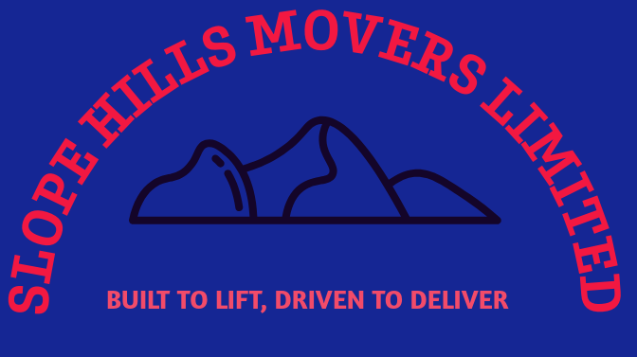
SLOPE HILL MOVERS LIMITED
BUILT TO LIFT, DRIVEN TO DELIVER

Slide 2
COMPANY OVERVIEW
Incorporated in 2016, Slope Hill Movers has grown to be a juggernaut and leader in the heavy lifting machinery sector.
We boast of a large and comprehensive fleet that is suited to fulfill any need or demands that our clients may require. This includes:
mobile cranes
Excavators
loaders
lorries
trailers
Other specialized equipment

Slide 3
OUR TEAM COMMITMENT TO QUALITY
Our team consists of highly skilled, driven and dedicated professionals who ensure the reliable performance of all our machinery.
We pride ourselves on delivering top-notch service in terms of timely project delivery and in meeting demand requirements.
Our staff boasts of extensive training and years of tackling problems and creating solutions. This enables us to possess the expertise needed to tackle even the most challenging projects.
Our unwavering commitment to quality and customer satisfaction has established us as a trusted partner in this industry.
We ensure the reliability of our machinery through rigorous maintenance and quality control processes.
We comply with industry safety regulations ensuring all our machinery are safe to use and easy to control using the provided manuals.

Slide 4
OUR SERVICES CORE VALUES
Heavy lifting and rigging – We utilize our advanced machinery and skilled personnel to offer heavy lifting and rigging services.
Equipment rental – Our comprehensive fleet is always available for rental helping to meet any specific needs you might have.
Consultation and planning – We offer expert consultation and planning services to help clients optimize their heavy lifting operations.
Projects help – We have a portfolio of completed projects showcasing our capability to help you in complex tasks that might arise.
Integrity –. We conduct our business with the highest ethical standards and transparency
Safety – We are committed to maintaining a safe working environment for our staff and clients.
Customer-focused – We are fully customer-driven and dedicated to meeting their needs.
Excellence – We strive for excellence in every aspect of our operations.
Teamwork – We believe in the power of teamwork and collaboration to achieve our common goals.

Slide 5
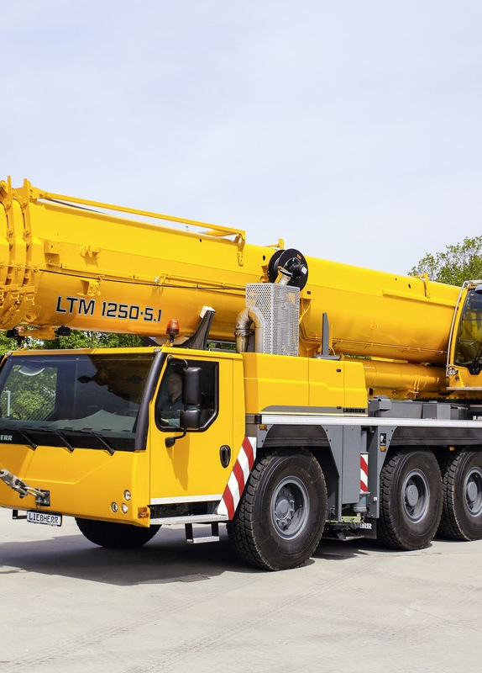
Mobile Cranes
Our mobile cranes are versatile and can be easily transported between locations providing efficiency in operations and flexibility.
They are used in construction projects for lifting and moving heavy materials on construction sites and in industrial installations.

Slide 6
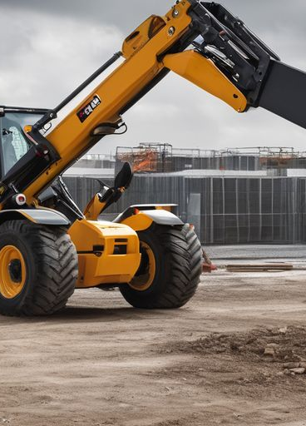
Forklifts
Facilitate easy movement, lifting and stacking of goods in warehouses and construction sites.

Slide 7
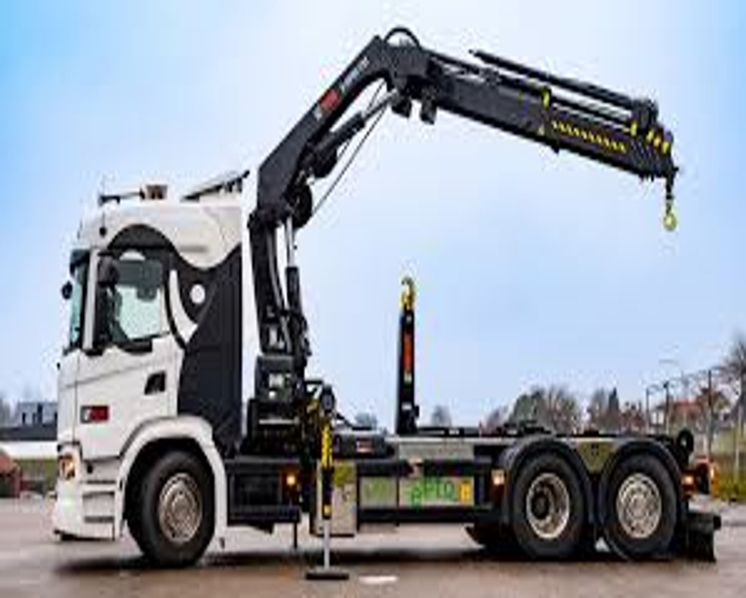
Hiab trucks
They come equipped with cranes to allow loading and unloading heavy foods efficiently. They are also used in transportation of equipment and materials between project sites.

Slide 8
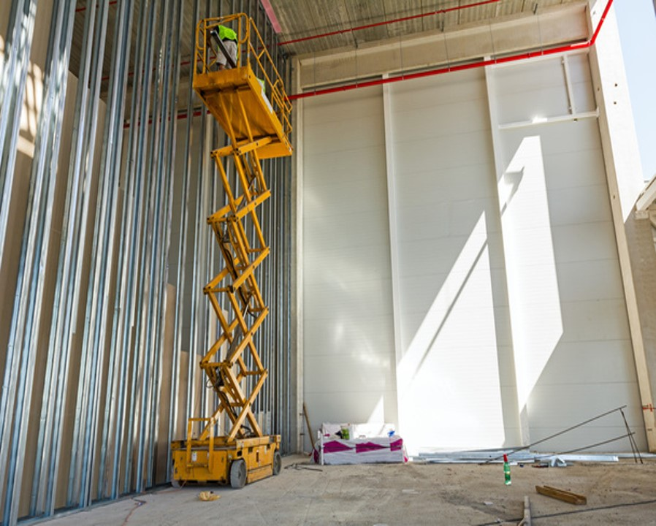
Cherry picker
Our cherry pickers allow safe and efficient access to high areas making working and maintenance at elevated heights easier.

Slide 9
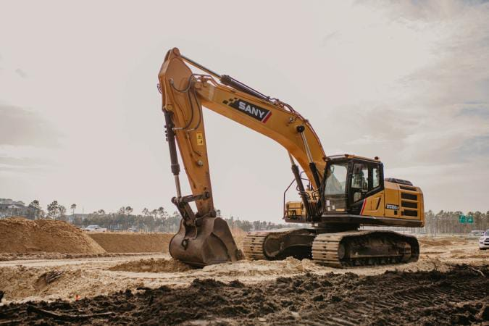
Excavators
Used in digging, trenching and earthmoving tasks.

Slide 10
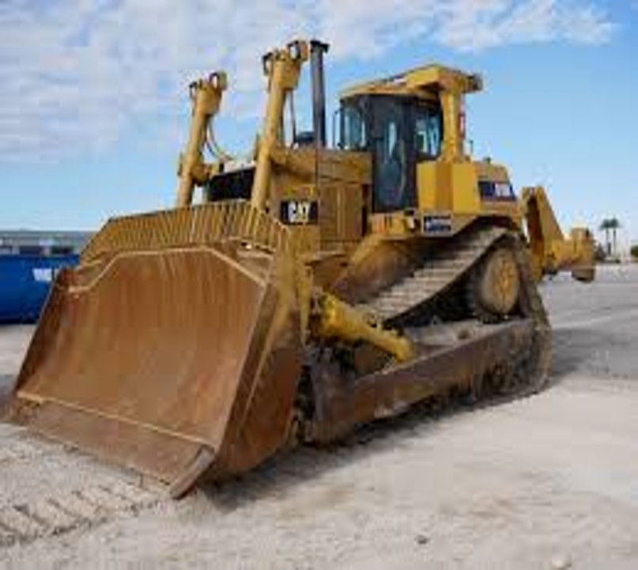
Dozers
Dozers are powerful machines used for pushing soil, sand, and debris. Our staff use them to prepare sites, road building and clearing land for earthmoving.

Slide 11
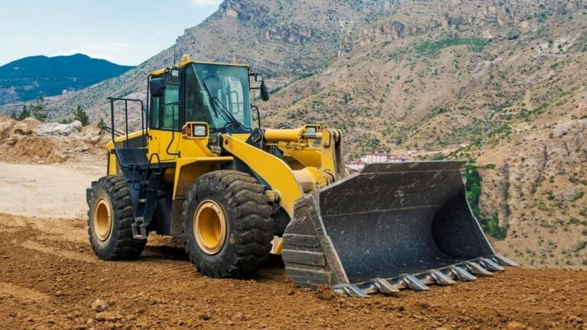
Wheel loader
Load materials into trucks, move debris and stockpile materials.

Slide 12
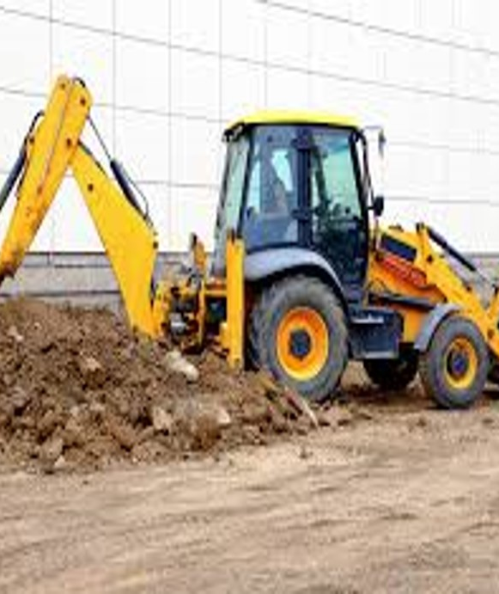
Backhoes
Backhoes are versatile machines with digging buckets and backhoes. They are used for excavation, trenching and lifting tasks.

Slide 13
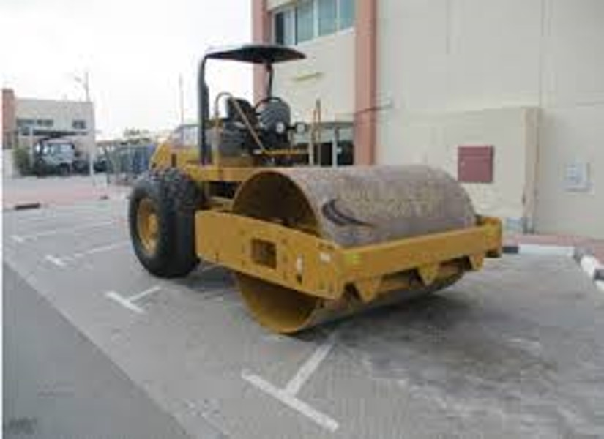
Roller
Essential for road construction and paving by compacting soil, gravel and asphalt.

Slide 14
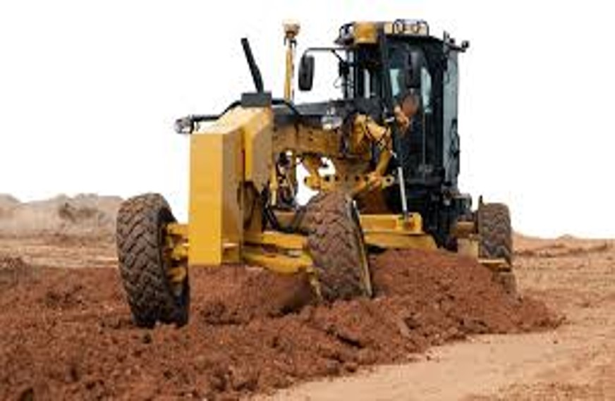
Grader
Used to create a smooth and level surface by ensuring proper grading and drainage.

Slide 15
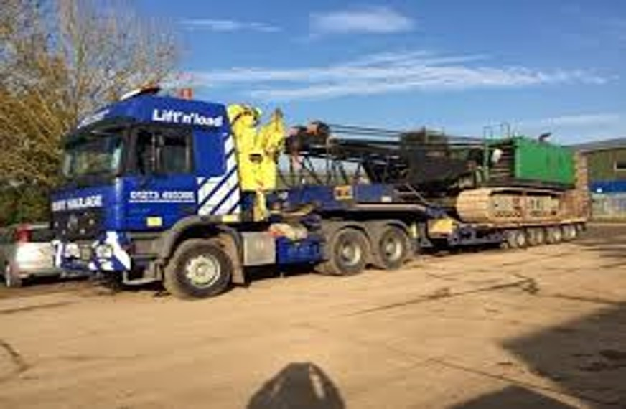
Lowloader
These are specialized trailers designed to transport oversized or heavy loads.

Slide 16
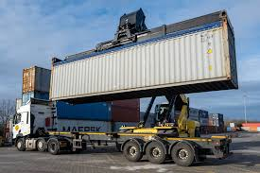
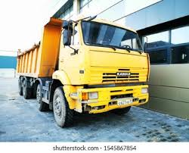
Trailers and Trucks
Trailers transport goods in standardized containers ensuring there’s efficient handling, storage and transport of materials.
Our trucks are used in the transportation of loose cargo which refers to goods that are not containerized. We ensure there is proper handling and securing to prevent damage during transport.

Slide 17
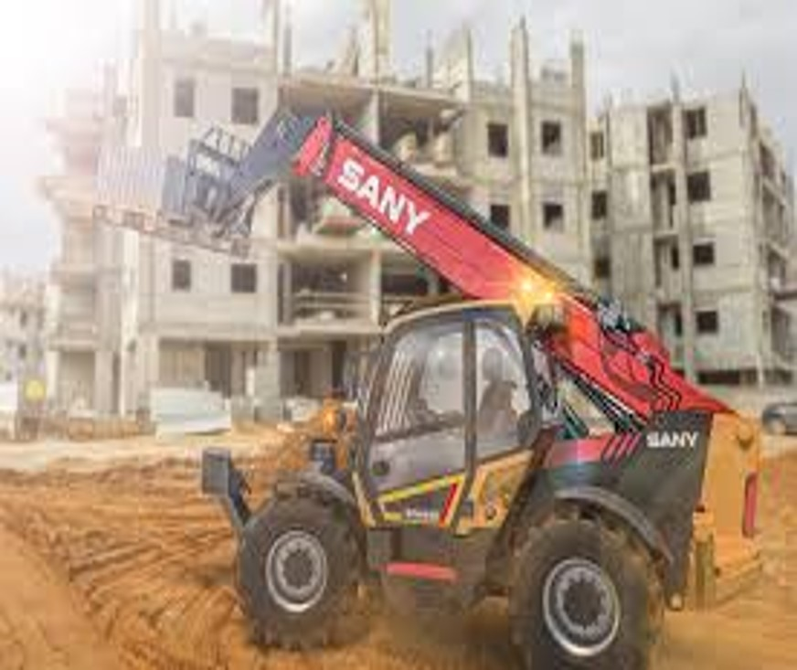
Telehandlers
These are versatile machines used for lifting and placing loads at various heights. They come equipped with telescopic booms that provide extended reach and lifting capabilities.

Slide 18
SLOPE HILL MOVERS LTD.
OUR MISSION
OUR VISION
To provide effective and efficient heavy lifting solutions that exceed our clients’ expectations.
To be the leading provider of innovative and reliable heavy lifting solutions, setting the standard for excellence in the industry.

Slide 19
Contact us:
Phone:0707074323
Email:contact@slopehillsmoversltm.co.ke
Trust Slope Hills Movers Limited as your partner for all your heavy lifting needs and experience simplicity and perfection in quality, safety and customer satisfaction.

